Slide 1



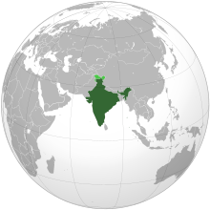


INDIAN CONSTITUTION

Slide 2
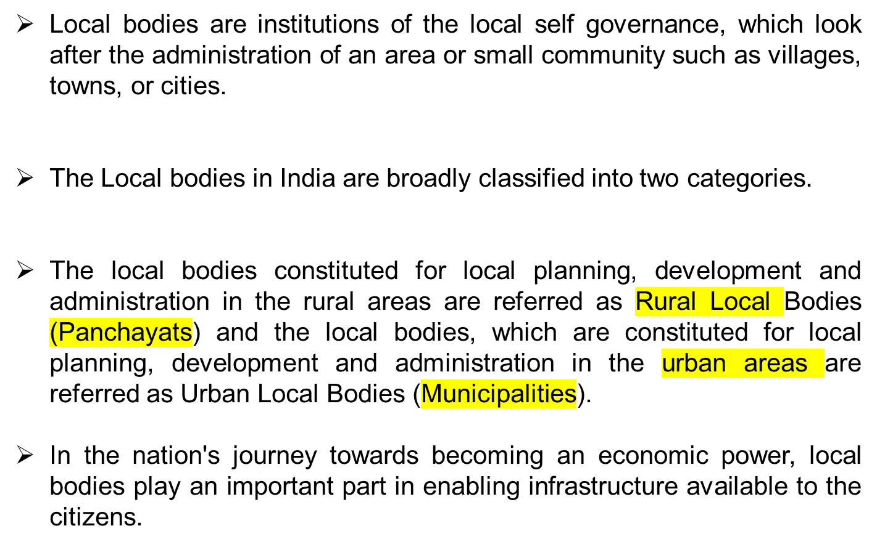
LOCAL GOVERNMENT/BODIES

Slide 3

The term ‘Panchayat Raj’ is relatively new, having originated during the British administration. 'Raj' literally means governance or government.
Mahatma Gandhi advocated Panchayati Raj, a decentralized form of Government where each village is responsible for its own affairs, as the foundation of India's political system.
His term for such a vision was "Gram Swaraj" or Village Self-governance. It was adopted by state governments during the 1950s and 60s as laws were passed to establish Panchayats in various states

Slide 4

Panchayati Raj is included in the State List of the Seventh Schedule of the Constitution.
It is the States that have been charged with the responsibility for the devolution of powers to the Panchayats.
After independence, Community Development Programme was started in 1952.
But because it was not attached with the people, therefore it could not prove to be a success story

Slide 5
In 1977, Ashok Mehta Committee was set up to review the working of Panchayats.
The committee found out that Panchayati Raj is the soul of democracy and therefore it should be empowered with more authority.
Those Panchayats which formed after 1977 are known as Second Generation Panchayats
In West Bengal, the Panchayats became more effective after accepting the suggestions made in this report

Slide 6
During the decade of 1990, it was realized that without constitutional power, the self-government can not be fruitful.
Therefore the Central Government passed the 73rd Constitutional Amendment Act in 1992, which became effective from 20 th April 1993 (from the date of publication in the Gazette of India).
The Constitution (73rd Amendment) Act, 1992 that came into effect in April 1993 brought about major reform in local governance in the country.

Slide 7

The panchayats receive funds from three sources
ie, local body grants, as recommended by the Central Finance Commission,
funds for the implementation of centrally-sponsored schemes, and
funds released by the state governments on the recommendations of the State Finance Commissions

Slide 8
Panchayat: A Panchayat means an institution (by whatever name called) of self-government constituted under article 243B of the Constitution of India for rural areas.
Panchayat area: A Panchayat area means the territorial area of a Panchayat;
Village: A village means a village specified by the Governor by public notification to be a village for the purposes of this Part and includes a group of villages so specified.
Gram Sabha: A Gram Sabha means a body consisting of persons registered in the electoral rolls relating to a village comprised within the area of Panchayat at the village level; Gram Sabha may exercise such powers and perform such functions at the village level as the Legislature of a State may, by law, provide.

Slide 9
Village level panchayat: It is called a Panchayat at the village level. It is a local body working for the good governance of the village.
Intermediate level panchayat: An Intermediate level means a level between the village and district levels specified by the Governor of a State by public notification to be the intermediate level for the purposes of this Part. Panchayats at the intermediate level may not be constituted in a State having a population not exceeding twenty lakhs.
District-level Panchayat: In the district level of the panchayati raj system, there is zilla parishad. It looks after the administration of the rural area of the district and its office is located at the district headquarters.

Slide 10
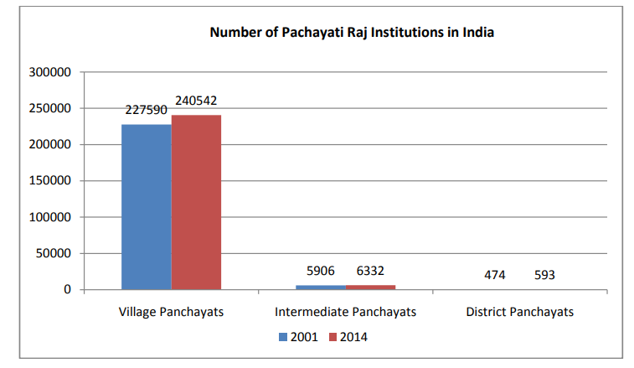

Slide 11
Duration of Panchayats
Every Panchayat, unless sooner dissolved under any law for the time being in force, shall continue for five years from the date appointed for its first meeting and no longer

Slide 12
Powers, authority and Responsibilities of Panchayats
the preparation of plans for economic development and social justice; and •
the implementation of schemes for economic development and social justice a

Slide 13
Powers to impose taxes by, and Funds of, the Panchayats
authorize a Panchayat to levy, collect and appropriate such taxes, duties, tolls and fees in accordance with such procedure and subject to such limits;
assign to a Panchayat such taxes, duties, tolls and fees levied and collected by the State Government for such purposes and subject to such conditions and limits;
provide for making such grants-in-aid to the Panchayats from the Consolidated Fund of the State; and
provide for Constitution of such Funds for crediting all moneys received, respectively, by or on behalf of the Panchayats and also for the withdrawal of such moneys

Slide 14
-THANK YOU-

